Slide 1



SOKOBAN
Khaled Mhjazi
Hind Dakkeh
Halmstad University

Slide 2

Discussion
* Introduction
* MVC - Model View Controller
* Strategy Pattern
* Observer Pattern
* Questions

Slide 3
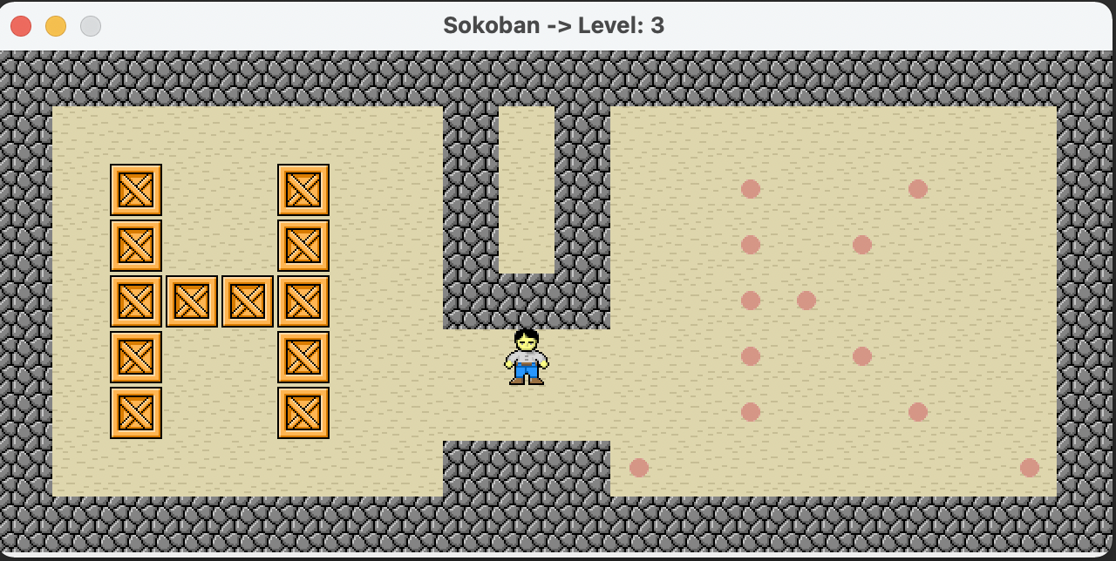
Introduction

Slide 4
MVC
View: Manages the visual representation and display of the game using observer pattern.
Controller: Receives and processes user input using the Strategy pattern.
Model: The mind of game that manage all game components that work Together

Slide 5
Strategy Pattern: use to handle the movement logic of the player, by defining different strategies for movement.
Observer Pattern: allows the efficient communication between game components.

Slide 6
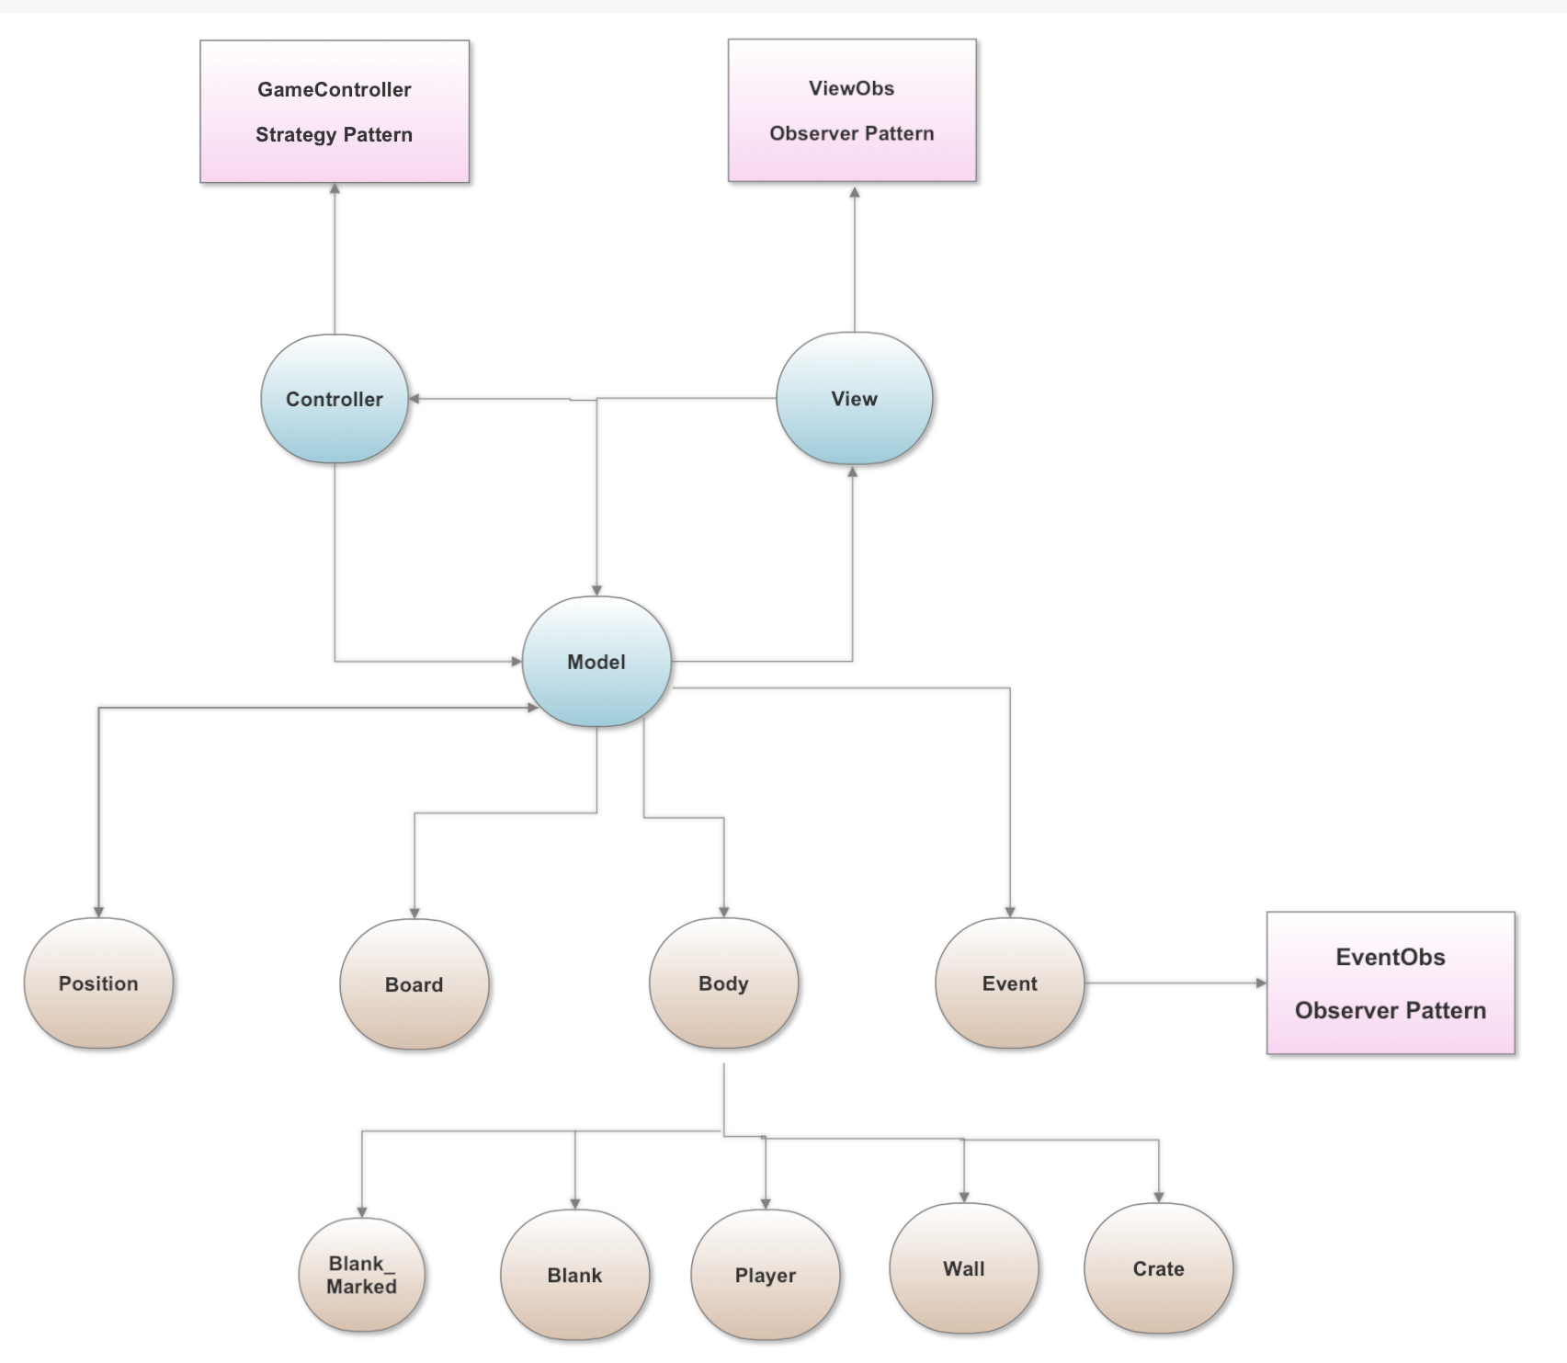

Slide 7
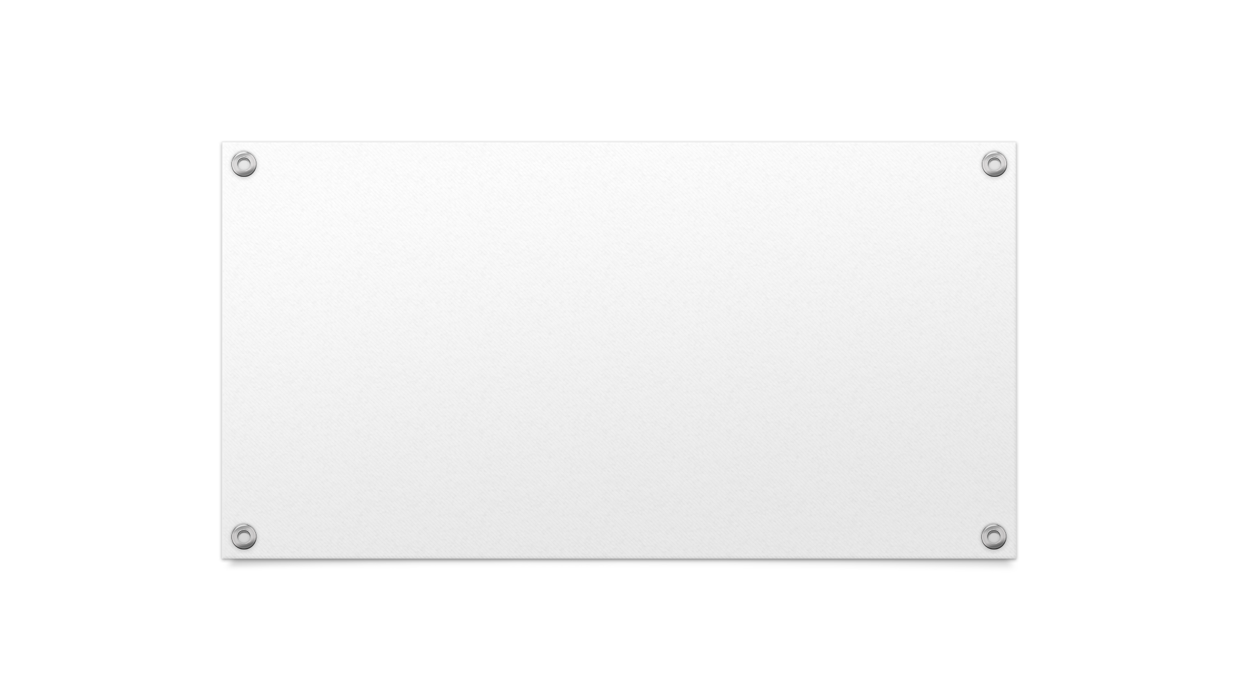

Questions

